Slide 1
Algorithms: Design
Recurrence Relations
C. Oswald
VIT Chennai
The class notes are a compilation and edition from many sources from the materials of my algorithm guru Dr. Sadagopan(IIITDM), books by CLRS, Michael T. Goodrich et al., etc. The faculty does not claim intellectual property or ownership of the lecture notes. Thanks to them!

Slide 2
Recursive Algorithms
A recursive algorithm is one in which objects are defined in terms of other objects of the same type
Advantages:
Simplicity of code
Easy to understand
Disadvantages
Memory
Speed
Possibly redundant work

Slide 3
Recursive Algorithms: Analysis
We have already discussed how to analyze the running time of (iterative) algorithms
To analyze recursive algorithms, we require more sophisticated techniques
Specifically, we study how to define & solve recurrence relations

Slide 4
Motivating Examples: Factorial
Recall the factorial function:
Consider the following (recursive) algorithm for computing n!
Factorial
Input: n∈N
Output: n!
If (n=1) or (n=0)
Then Return 1
Else Return n × Factorial(n-1)
Endif
End
 | 1 | if n= 1
n! =
 | n.(n-1) | if n > 1

Slide 5
Factorial: Analysis
How many multiplications M(x) does factorial perform?
When n=1 we don’t perform any
Otherwise, we perform one…
… plus how ever many multiplications we perform in the recursive call Factorial(n-1)
The number of multiplications can be expressed as a formula (similar to the definition of n!
T(0) = 0
T(n) = 1 + T(n-1)
This relation is known as a recurrence relation

Slide 6
Recurrence Relations
As many algorithms are recursive in nature, it is natural to analyze algorithms based on recurrence relations. E.g. Divide and conquer strategies.
Recurrence relation is a mathematical model that captures the underlying time-complexity of an algorithm.
Definition: A recurrence relation for a sequence {a_{n}} is an equation that expresses a_{n} in terms of one or more of the previous terms in the sequence:
a₀, a₁, a₂, …, a_{n-1}
for all integers n≥n₀ where n₀ is a nonnegative integer.
A sequence is called a solution of a recurrence if its terms satisfy the recurrence relation

Slide 7
Recurrence Relations: Example
The Fibonacci numbers are defined by the recurrence
F(n) = F(n-1) +F(n-2)
F(1) = 1
F(0) = 1
The solution to the Fibonacci recurrence is
f_{n} = 1/√5 ((1+√5)/2)^{n} – 1/√5 ((1-√5)/2)^{n}
(The solution is derived in your textbooks.)

Slide 8
Recurrence Relations: General Form
More generally, recurrences can have the form
T(n) = αT(n-β) + f(n), T(δ) = c
or
T(n) = αT(n/β) + f(n), T(δ) = c
Note that it may be necessary to define several T(δ), which are the initial conditions.

Slide 9
Recurrence Relations: Initial Conditions
The initial conditions specify the value of the first few necessary terms in the sequence.
In the Fibonacci numbers, we needed two initial conditions:
F(0) = F(1) = 1
because F(n) is defined by the two previous terms in the sequence
Initial conditions are also known as boundary conditions (as opposed to general conditions).
From now on, we will use the subscript notation, so the Fibonacci numbers are:
f_{n} = f_{n-1} + f_{n-2}
f₁ = 1
f₀ = 1

Slide 10
Recurrence Relations: Terms
Recurrence relations have two parts:
recursive terms and
non-recursive terms
T(n) = 2T(n-2) + n² -10
Recursive terms come from when an algorithms calls itself
Non-recursive terms correspond to the non-recursive cost of the algorithm: work the algorithm performs within a function
We will see examples later. First, we need to know how to solve recurrences.

Slide 11
Solving Recurrences
There are several methods for solving recurrences
Characteristic Equations
Iteration method
Substitution through Guess method
Recurrence Trees
Masters Theorem
… Maple! Maple and other math tools are great resources. However, they are no substitutes for knowing how to solve recurrences yourself. As such, you should only use Maple to check you answers.

Slide 12
Iteration method
Consider a computational problem P and an algorithm that solves P.
Let T(n) be the worst-case time complexity of the algorithm with n being the input size.
For searching and sorting, T(n) denotes the number of
comparisons incurred by an algorithm on an input size n.

Slide 13
Case studies: Searching and Sorting
Linear Search
Input: Array A, an element x.
Question: Is x € A.
- Let T(n) be the number of comparisons (time) required for linear search on an array of size n.
- When n = 1, T(1) = 1. else
Recurrence Relation - T(n) = T(n-1) + 1, n>1
- T(n) = 1 + T(n-1) = 1 +…+ 1 + T(1) and T(1) = 1
- T(n) = n-1 + 1 = n.
- i.e., T(n) = Ꝋ(n).

Slide 14
A recursive algo. for Sum of ‘n’ natural nos.
Test(n){
if(n>0)
return n + Test(n-1);
else
return 0;
}
T(n) = 1 + T(n-1), n>1
= 1 (any constant c), n=1

Slide 15
Solve recurrence for sum of n natural nos.
Solve: T(n) = 1 + T(n-1) n>1
= 1 n=1
T(n-1) = 1+ T(n-2)
T(n-2) = 1 + T(n-3)
T(n) = 1+ 1+ T(n-2) = 2 + T(n-2)
T(n) = 1 + 1+ 1+ T(n-3) = 3+ T(n-3)
T(n) = k + T(n-k) – (1)
n–k = 1; k = n-1;
T(n) = n-1 + T(n-n) = n-1 + T(1) = n
T(n) = Ꝋ(n)

Slide 16
Sorting
To sort an array of n elements using find_max (returns maximum) as a black box.
Approach: Repeatedly find the maximum element and remove it from the array. The order in which the maximum elements are extracted is the sorted sequence.
T(n) = T(n-1) + n-1 = T(n-2) + n-2 + n-1 = T(1) + 1 + ... + n-1
= (n(n-1))/2
= Ꝋ(n²).

Slide 17
CW
2. Solve T(n) = n + T(n-1) n>1
= 1 n=1

Slide 18
CW Answer
2. Solve T(n) = n + T(n-1) n>1
= 1 n=1
T(n) = n+ T(n-1) (1)
T(n-1) = n-1 + T(n-2) (2)
T(n-2) = n-2 + T(n-3) (3)
Back Substituting (2) in (1) we get
T(n) = n+(n-1)+ T(n-2)
n+(n-1)+(n-2)+T(n-3)
n+(n-1)+(n-2)+ …. + (n-k) + T(n-(k+1))
Here, for n-(k+1)=1
k=n-2
Replacing k=n-2;
T(n) = n+(n-1)+(n-2)+ …+ (n-n+2) + T(n-(n-2+1))
= n+(n-1)+(n-2)+…+2+1
= n(n+1)/2
T(n) = O(n²)

Slide 19
Binary search
Input: Sorted array A of size n, an element x to be searched.
Question: Is x € A.
Check whether A[n/2] = x. If x > A[n/2], prune left half, else right half.
Recurrence Relation : ?
T(n) = 1 + T(n/2), n >1
1, n = 1

Slide 20
Binary search
Input: Sorted array A of size n, an element x to be searched.
Question: Is x € A.
Check whether A[n/2] = x. If x > A[n/2], prune left half, else right half.
T(n) = T(n/2) + 1; n>1; else T(n) = 1 if n = 1
T(n/2) = 1+ T(n/4);
= T(n/4) + 1 +1
= T(n/8) + 1+ 1+ 1
= T(n/2³) + 3
…
⁼ T(n/2^{k}) + k => 1 + log₂n => log₂n <= 1+log₂n <= 2log₂n, for all n>=2
= T(1) + k => n/2^{k} = 1, n = 2^{k}; log₂n = log₂2^{k}; k= log₂n. T(n) = Ꝋ(log₂n).

Slide 21
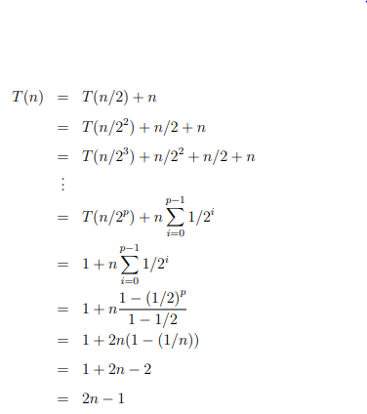
Substitution…
Solve : T(n) = T(n/2) + n, n>1, else T(n) = c, n =1.

Slide 22
Recursion is Mathematical Induction
In both we have general and initial conditions with the general condition breaking the problem into smaller and smaller pieces.
The initial or initial condition terminate the recursion.
Induction provides a useful tool to solve recurrences guess a solution and prove it by induction.
Let’s see how… before that recall Induction concept.

Slide 23
Substitution Method(Guess and Prove…)
2. Recurrence: T(1) = 1 and T(n) = 2T(⌊n/2⌋)+ n for n > 1
We guess that the solution is T(n) = O(n log n). So we must prove that T(n) ≤ cnlogn for some constant c. (We will get to n₀ later, but for now let’s try to prove the statement for all n ≥ 1.)
As per our inductive hypothesis, we assume T(n) ≤ cnlogn for all positive numbers less than n. Therefore, T(⌊n/2⌋) ≤ c ⌊n/2⌋ log(⌊n/2⌋)), and
T(n) ≤ 2(c ⌊n/2⌋ log(⌊n/2⌋)) + n
≤ cn log(n/2) + n
= cn log n − cn log 2 + n
= cn log n − cn + n
≤ cn log n (for c ≥ 1)
Now we need to show the base case. This is tricky, because if T(n) ≤ cnlogn, then T(1) ≤ 0, which is not a thing. So we revise our induction so that we only prove the statement for n ≥ 2, and the base cases of the induction proof (which is not the same as the base case of the recurrence!) are n = 2 and n = 3. (We are allowed to do this because asymptotic notation only requires us to prove our statement for n ≥ n₀, and we can set n₀ = 2.)

Slide 24
Substitution method through Guess…
We choose n = 2 and n = 3 for our base cases because when we expand the recurrence formula, we will always go through either n = 2 or n = 3 before we hit the case where n = 1.
So proving the inductive step as above, plus proving the bound works for n = 2 and n = 3, suffices for our proof that the bound works for all n > 1.
Plugging the numbers into the recurrence formula, we get T(2) = 2T(1) + 2 = 4 and T(3) = 2T(1) + 3 = 5. So now we just need to choose a c that satisfies those constraints on T(2) and T(3). We can choose c = 2, because 4 ≤ 2*2 log2 and 5 ≤ 2*3 log3.
Therefore, we have shown that T(n) ≤ 2n log n for all n ≥ 2, so T(n) = O(n log n)

Slide 25
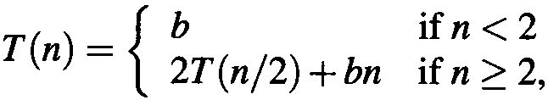
Substitution method – In a Nutshell
In guess-and-prove method the solution to a recurrence equation is guessed and then proved by mathematical induction
We guess that T(n) = O(n log n). We have to prove that T(n) < C n· log n for some constant C and large enough n.
We use inductive assumption that T(n/2) < C · n/2 · log (n/2) = Cn/2·(log n –1) = (Cn · log n)/2 – Cn/2.
T(n) = 2T(n/2) +bn < 2((Cn · log n)/2 – Cn/2) +bn = Cn · log n + (-Cn + bn) < Cn · log n, for any C > b.

Slide 26
Substitution Method
1. Solve: T_{n} = 2 T(n-1) + 1, T₀ = 0
Guess what the solution is?
Prove T_{n} = 2^{n} – 1 by induction
Show that the base case is true: T⁰ = 2⁰ – 1 = 0
Now assume true for T_{n-1}.
Using this assumption show:
T_{n} = 2 T(n-1) + 1 = 2(2^{n-1} – 1) + 1 = 2^{n} – 1 = O(2^{n}).
n | 0 | 1 | 2 | 3 | 4 | 5 | 6 | 7
T_{n} | 0 | 1 | 3 | 7 | 15 | 31 | 63 | 127

Slide 27
Warnings!
Using the substitution method, it is easy to prove a weaker bound than the one you’re supposed to prove. For instance, if the runtime is O(n), you might still be able to substitute cn² into the recurrence and prove that the bound is O(n² ). Which is technically true, but don’t let it mislead you into thinking it’s the best bound on the runtime. People often get burned by this on exams!
You must prove the exact form of the induction hypothesis. For example, in the recurrence T(n) = 2T(n/2) + n, we could falsely “prove” T(n) = O(n) by guessing T(n) ≤ cn and then arguing T(n) ≤ 2(cn/2) + n ≤ cn + n = O(n). Here we needed to prove T(n) ≤ cn, not T(n) ≤ (c + 1)n. Accumulated over many recursive calls, those “plus ones” add up.

Slide 28
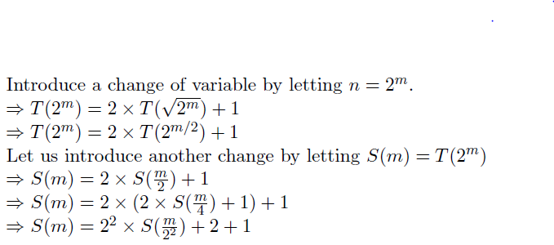
Change of Variable Technique – Not in syllabus (for interested folks)
Solve: T(n) = 2T(√n) + 1 and T(1) = 1

Slide 29
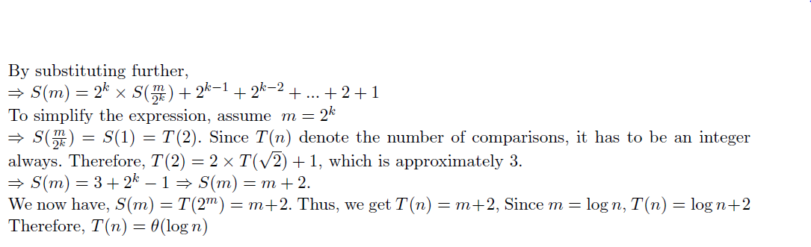
Change of Variable Technique(contd.)

Slide 30
Exercises
Solve by change of variable method:
T(n) = 2T(√n) + n and T(1) = 1.
T(n) = 3T(√n) + logn and T(1) = 1.
3. T(n) = 2T (√n) + log n and T(1) = 1.

Slide 31
Recurrence Trees
When using recurrence trees, we graphically represent the recursion.
Each node in the tree is an instance of the function. As we progress downward, the size of the input decreases.
The contribution of each level to the function is equivalent to the number of nodes at that level times the non-recursive cost on the size of the input at that level.
The tree ends at the depth at which we reach the base case.
As an example, we consider a recursive function of the form
T(n) = αT(n/β) + f(n), T(δ) = c

Slide 32
Example - 1
T(n) = 2T(n/2) + c, n>1
= c n=1
c+2c+4c+8c+nc
c(1+2+4+8+…..+2^{k})
c{1(2^{k+1}-1)/(2-1)}
c(2^{k+1}-1)
c((2^{k} * 2¹ )-1); k = ?; 2^{k} = n; log₂2^{k} = log₂n; k = log₂n;
c(2.2^{log}₂^{n} -1) = 2n -1.
T(n) = O(n)

Slide 33
Recurrence Tree – e.g. 1
Input Size Reduction Tree
2⁰*c(number of recursive calls)
2¹*c
2²*c
2³*c
.
.
.
2^{k}*c
Computation Cost Tree
Iteration
0
1
2
.
.
k
.
.
log₂ n
T(n)
T(n/2)
T(n/2)
T(n/4)
T(n/4)
T(n/4)
T(n/4)
T(n/8)
T(n/8)
T(n/8)
T(n/8)
T(n/8)
T(n/8)
T(n/8)
T(n/8)

Slide 34
Example - 2… (Similar to previous one)
Consider the following concrete example
T(n) = 2T(n/2) + n, T(1)= 4

Slide 35
Example - 2… (Similar to previous one)
Consider the following concrete example
T(n) = 2T(n/2) + n, T(1)= 4
Determine cost of each level-
Cost of level-0 = n
Cost of level-1 = n/2 + n/2 = n
Cost of level-2 = n/4 + n/4 + n/4 + n/4 = n and so on.
WKT, at level k, n/2^{k} = 1; 2^{k} = n; log₂2^{k} = log₂n; k = log₂n;
Total levels in the tree = log₂n + 1
Cost of last level = n * T(1) = 4n = O(n)
Cost of remaining log₂n levels = n + n + n + … log₂n = nlog₂n
T(n) = nlog₂n + 4n = O(nlog₂n)

Slide 36
Recurrence Tree – e.g. 2
Input Size Reduction Tree
Computation Cost Tree
Iteration
0
1
2
.
.
k
.
.
.
log₂ n
n
n/2 + n/2 = 2.n/2
4. n/4
8.n/8
.
.
2^{k}(n/2^{k})
.
T(n)
T(n/2)
T(n/2)
T(n/4)
T(n/4)
T(n/4)
T(n/4)
T(n/8)
T(n/8)
T(n/8)
T(n/8)
T(n/8)
T(n/8)
T(n/8)
T(n/8)

Slide 37
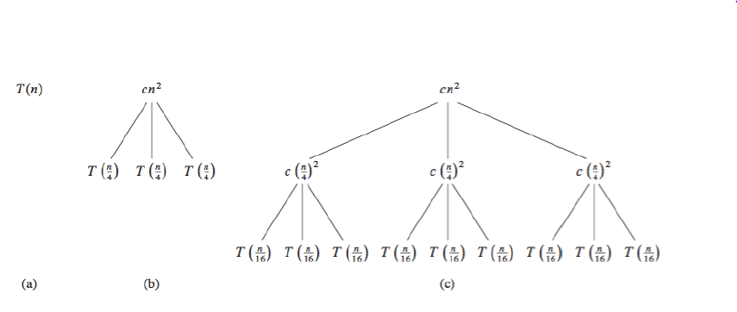
Example – 3 (Ref: CLRS)
T(n) = 3T(n/4) + (n²)

Slide 38
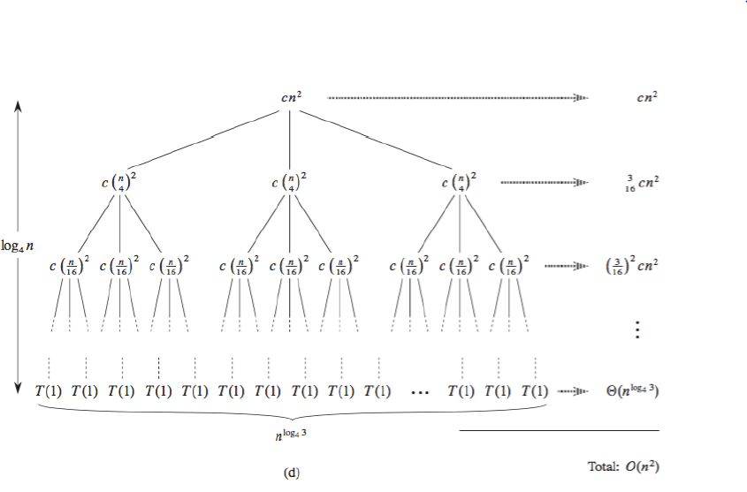
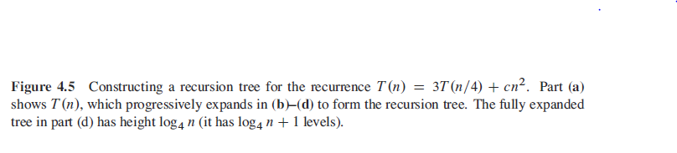

Slide 39
Example 3
First we find the height of the recursion tree. Observe that a node at depth i reflects a subproblem of size n/4^{i}. The subproblem size hits n = 1 when n/4^{i} = 1, or i = log₄n. So the tree has log₄n + 1 levels.
Now we determine the cost of each level of the tree. The number of nodes at depth i is 3^{i}.
Each node at depth i = 0,1,…,log₄n-1 has a cost of c(n/4^{i})², so the total cost of level i is 3^{i}c(n/4^{i})² = (3/16)^{i}cn². However, the bottom level is special. Each of the bottom nodes contribute cost T(1), and there are 3^{log}₄^{n} = n^{log}₄³ of them.

Slide 40
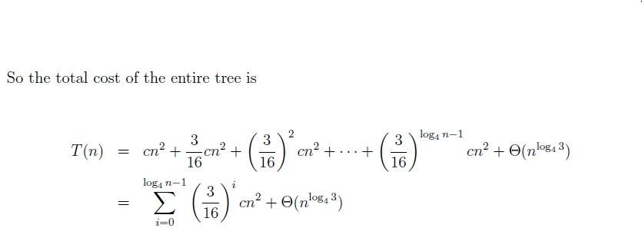
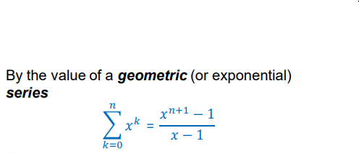

Slide 41
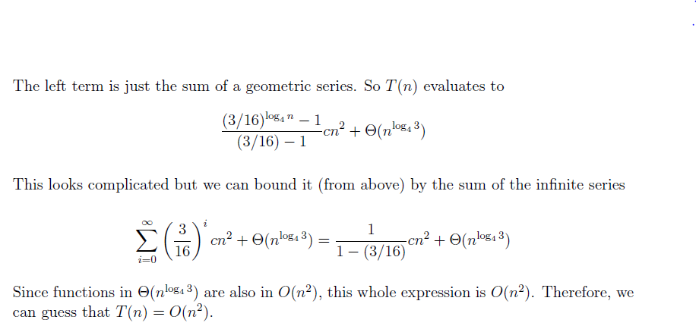

Slide 42
Masters Theorem(From CLRS) – A ‘Cook Book’ for RR
It presents a framework and formulae using which solutions to many recurrence relations can be obtained very easily.
Almost all recurrences of type T(n) = aT(n/b) + f(n) can be solved easily by doing a simple check and identifying one of the three cases mentioned in the following theorem.
By comparing n^{log}_{b}ª (number of leaves) with f(n), one can decide upon the time complexity of the algorithm.

Slide 43
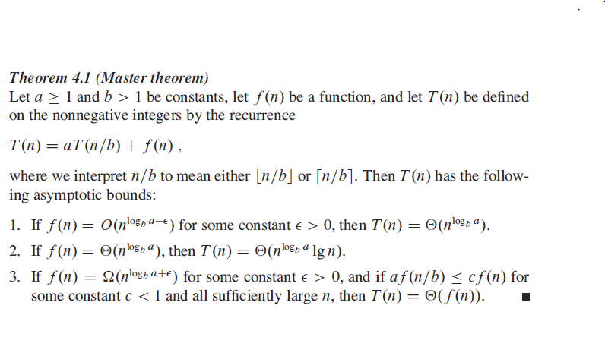
Masters Theorem(From CLRS)

Slide 44
Master’s Theorem – E.g. 1
T(n) = 9T(n/3) + n
a = 9 and b = 3
g(n) = n^{log}_{b}ª = n^{log}₃⁹ = n²
f(n) = n
Comparing n^{log}_{b}ª and f(n), we get f(n) = O(n²).
Satisfies Case 1 of Master's Theorem,
T(n) = Ꝋ(n^{log}_{b}ª) = Ꝋ(n²)

Slide 45
Master’s Theorem – E.g. 2
T(n) = T(2n/3) + 1
a = 1 and b = 3/2
g(n) = n^{log}_{b}ª = n^{log}_{3/2}¹ = n⁰ = 1 = f(n)
Comparing n^{log}_{b}ª and f(n), we get f(n) = Ꝋ(g(n)).
Satisfies Case 2 of Master's Theorem,
T(n) = Ꝋ(n^{log}_{b}ªlogn) = Ꝋ(logn)

Slide 46
Master’s Theorem – E.g. 3
T(n) = 2T(n/2 ) + 2^{n}
g(n) = n^{log}_{b}ª = n^{log}₂² = n and f(n) = 2^{n}
Clearly f(n) = 2^{n} = Ω(n^{log}_{a}^{b+ε}) = Ω(n^{log}₂^{2+ε}), for any ε>0.
∴ Case 3 of master theorem applies.
Regularity condition check : af(n/b) ≤ cf(n) = 2. 2^{n/2} ≤ c. 2^{n}
Clearly there exists c < 1 for n ≥ 4, for example c = ½.
Case 3 applies.
∴ T(n) = Ꝋ(f(n)) = Ꝋ(2^{n}).

Slide 47
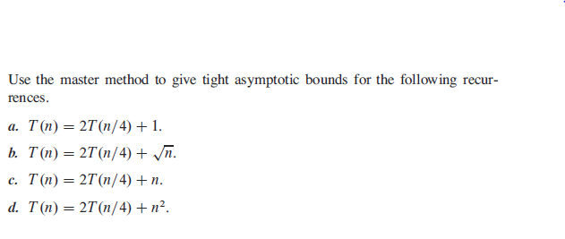
Try using master’s theorem

Slide 48
Solve using Iteration/Substitution/Recurrence Tree/Master’s Theorem whichever is applicable.
If a method is not applicable, defend why. 1. T(n) = T(n-1) + T(n-2) + c, n≥2; T₀ = 0, T₁= 1. 18. T(n) = 4T(n/2) + 4n 37. T(n) = 16T(n/4) + n² if n ≥3
2. T(n) = T(n/2) + cn², n ≥ 2; c, if n=1 19. T(n) = T(n+5) + n 38. T(n) = T(9n/10) + n if n ≥ 3
3. T(n) = 2T(n/2) + 1 for n>1; c, if n=1 (also for n/4) 20. T(n) = 3T(n/4) + cn 39. T(n) = 2T(n/2) + n³ if n ≥ 3
4. T(n) = 2T(n/2) + cn² for n ≥ 2; c if n=1 21. T(n) = 2T(n/2 + 17) + n 40. T(n) = 8T(n/2) + nlogn
5. T(n) = 7T(n/3) + cn² n ≥ 3; c, if n<=2 22. T(n) = 4T(n/4) + cn²
6. T(n) = T(n/2) + clogn if n ≥ 2; c, if n = 1. 23. T(n) = 9T(n/3) + n²logn 41. T(n) = T(n/2 + 5) + n, n>2
7. T(n) = 2T(n/2) + (logn)² if n ≥ 3; c, if n = 1, 2 24. T(n) = 2T(n/2) + n/logn
8. T(n) = 4T(n/2) + clogn if n ≥ 2; c, if n = 1 25. T(n) = 2T(n/2) + n/n⁴
9. T(n) = 3T(n/2) + cn if n ≥ 2, c if n = 1 26. T(n) = 2T(n/2) + n/2^{n}
10. T(n) = 7T(n/2) + cn², if n>2, c if n≤2. 27. T(n) = 4T(n/2) + n²logn
11. T(n) = 2T(n/2) + cnlogn, if n ≥ 2, c if n = 1. 28. T(n) = 2T(n/2) + n² n^{(1+sin(n))}
10. Recurrence for Towers of Hanoi and solve. 29. T(n) = 4T((n/2) + 2) + n
11. T(n) = 3T(n/2) + cnlogn, if n ≥ 2, c if n = 1. 30. T(n) = 8T(n/2) + Ꝋ(n²), 1 if n = 1.
12. T(n) = T(n/4) + cnlogn, if n ≥ 2, c if n = 1. 31. T(n) = 7T(n/2) + Ꝋ(n²), 1 if n = 1.
13. T(n) = T(n/2) + T(n/4) + cn, if n ≥ 5, c if n<=4. 32. T(n) = 4T(n/3) +n.
14. T(n) = 64T(n/2) + √n, if n ≥ 2, c if n = 1. 33. T(n) = 4T(n/2) + cn²
15. T(n) = 32T(n/2) + n²logn, if n ≥ 2, c if n = 1. 34. T(n) = T(n/3) + 2T(n/3) + O(n) 16. T(n) = T(n-1) + T(n/2) + n. 35. T(n) = T(n/10) + T(9n/10) + cn 17. T(n) = 4T(n/2) + cn 36. T(n) = 4T(n/4) + cnlogn.

Slide 49
Reading Assignment
Read Chapter 1-3 in [CLRS]
Chapter 1 introduces the notion of an algorithm
Chapter 2 analyzes some sorting algorithms
Chapter 3 introduces growth of functions

Slide 50
Thank You

